Slide 1
DISPENSARY DATABASE SYSTEM
PRESENTED BY
BATCH NO: 21
K.SAI KUMAR-23H51A6224
D.SAI CHARAN-23H51A678
D.MANJULA-23H51A6279

Slide 2
TABLE OF CONTENTS
01 02 03 04 05
PROBLEM STATEMENT OBJECTIVES ALGORITHM ER DIAGRAM OUTPUT

Slide 3
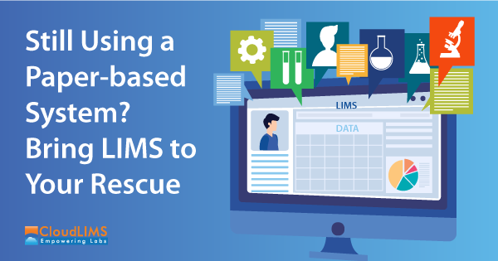
PROBLEM STATEMENT
Problem statement : The management of dispensaries, which include tracking medications, managing patient information, and handling inventory, is often done manually or through inefficient paper-based systems. This can lead to a host of issues including poor inventory management, delayed processing of patient requests, prescription errors, and a lack of centralized data for reporting and decision-making.

Slide 4
OBJECTIVES
Inventory Management:
Ensure efficient tracking and management of medication stock, including real-time updates on quantities, expiration dates, and automated alerts for low stock levels.
2. Patient Information and Prescription Management:
Centralize the storage of patient records and prescription details, enabling accurate tracking of medical history and reducing prescription errors
3. Sales and Billing Automation:
Streamline the billing process by automating sales transactions, generating invoices, and managing payment records for transparency and efficiency.
4. Data Security and Access Control:
Implement robust security measures to protect sensitive patient information, with role-based access control and regular data backups to ensure system reliability and compliance with data privacy regulations.

Slide 5
ALGORITHM
Step-1: Create Tables in MySQL:
Patients: Store patient information (ID, Name, Address, Contact, Medical History, etc.)
Medications: Store medication details (ID, Name, Stock Quantity, Expiration Date, Supplier Info, etc.)
Prescriptions: Store prescription records (Prescription ID, Patient ID, Doctor ID, Medication ID, Dosage, Date, etc.)
Sales: Store sales transactions (Sale ID, Patient ID, Medication ID, Quantity, Total Price, Date, etc.)
Users: Store information about users (User ID, Name, Role, Username, Password, etc.) for access control.
Step 2: Add and Update Patient Information:
I.Insert New Patient:
Input: Patient details (name, contact, address, medical history)
II.Update Patient Information:
Input: Patient ID, updated information.
Step 3: Manage Inventory:
I.Add New Medication to Inventory:
Input: Medication details (name, stock, expiration date, supplier)
II.Update Medication Stock (when new shipment arrives or medication is sold):
Input: Medication ID, quantity to add.
III.Check for Low Stock/Expired Medications:
Input: Threshold for low stock, current date.

Slide 6
Step 4: Handle Prescription Management:
I.Create a New Prescription:
Input: Prescription details (patient ID, doctor ID, medication ID, dosage, date).
II.Retrieve Patient Prescription History:
Input: Patient ID.
Step 5: Process Sales:
I.Record a New Sale:
Input: Patient ID, Medication ID, Quantity, Sale Date.
II.Update Medication Stock after Sale:
Input: Medication ID, Quantity Sold.
Step 6: Security and Access Control:
I.Authenticate User:
Input: Username, Password
II.Role-Based Access Control:
If user role is "Admin", grant full access.
If user role is "Pharmacist", limit access to inventory and sales operations only.
Restrict access to sensitive data (e.g., patient information) based on user role.

Slide 7
Step 7: Reporting and Alerts:
I.Generate Inventory Report:
Input: Date Range, Stock Threshold (optional).
II.Generate Sales Report:
Input: Date Range.
Step 8: Backup and Data Recovery:
I.Schedule Regular Database Backups:
Automate daily/weekly backups of the database using MySQL backup tools
II.Data Recovery in Case of Failure:
Implement a recovery plan to restore data from backups if necessary.

Slide 8
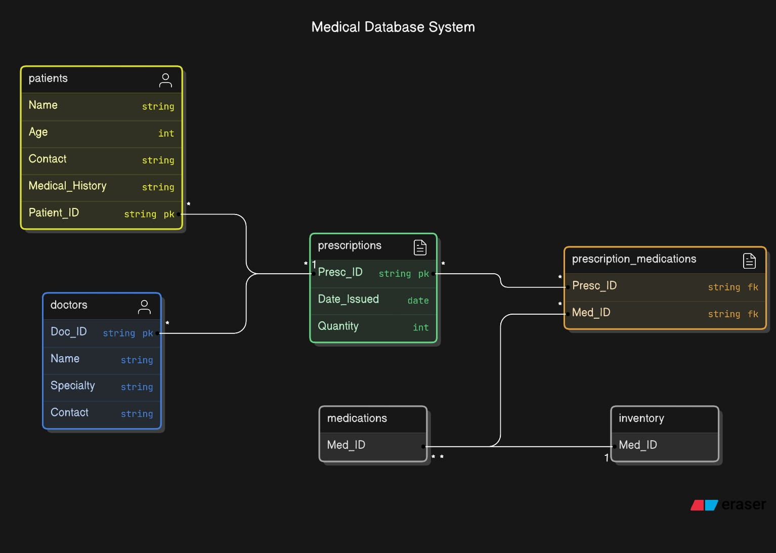
ER Diagram

Slide 9
INPUT/OUTPUT
Step 1: Initialize the Database:
- Input: None (Database schema creation and table definitions).
- Output: MySQL database with the following tables:
- `Patients`, `Medications`, `Prescriptions`, `Sales`, `Users`.
Step 2: Add and Update Patient Information:
1. Add New Patient:
- Input: Patient details (Name, Address, Contact, Medical History).
- Output: Confirmation of patient added to the database, e.g., "Patient added successfully."
2. Update Patient Information:
- Input: Patient ID, updated details (Name, Address, Contact, Medical History).
- Output: Confirmation of patient details updated, e.g., "Patient record updated."
Step 3: Manage Inventory:
1. Add New Medication:
- Input: Medication details (Name, Stock Quantity, Expiration Date, Supplier Information).
- Output: Confirmation of new medication added, e.g., "Medication added successfully."
2. Update Medication Stock:
- Input: Medication ID, Quantity to Add.
- Output: Updated stock level, e.g., "Stock updated successfully."
3. Check for Low Stock/Expired Medications:
- Input: Stock threshold, current date.
- Output: List of medications that are below the stock threshold or expired.

Slide 10
Step 4: Handle Prescription Management:
1. Create New Prescription:
- Input: Patient ID, Doctor ID, Medication ID, Dosage, Date.
- Output: Confirmation of prescription creation, e.g., "Prescription added successfully."
2. Retrieve Patient Prescription History:
- Input: Patient ID.
- Output: List of prescriptions related to the patient.
Step 5: Process Sales
1. Record New Sale:
- Input: Patient ID, Medication ID, Quantity Sold, Total Price, Sale Date.
- Output: Confirmation of the sale, e.g., "Sale recorded and invoice generated."
2. Update Stock After Sale:
- Input: Medication ID, Quantity Sold.
- Output: Updated stock, e.g., "Medication stock updated.
Step 6: Security and Access Control:
1. Authenticate User:
- Input: Username, Password.
- Output: Role of the user (Admin/Pharmacist/Doctor) if authentication is successful; otherwise, "Login failed."
2. Role-Based Access Control:
- Input: User role.
- Output: Permission to access specific features (e.g., Admin can access all, Pharmacist limited to inventory and sales).

Slide 11
Step 7: Reporting and Alerts:
1. Generate Inventory Report:
- Input: Stock threshold, Date Range.
- Output: Inventory report showing stock levels and expiration dates.
2. Generate Sales Report:
- Input: Date Range.
- Output: Sales report showing medication sales, total sales, and revenue
Step 8: Backup and Data Recovery:
1. Schedule Database Backup:
- Input: Backup schedule (Daily, Weekly).
- Output: Confirmation of backup completion.
2. Data Recovery:
- Input: Backup file.
- Output: Restored database to the latest backup state, e.g., "Data restored successfully

Slide 12
THANK YOU…

